Slide 1
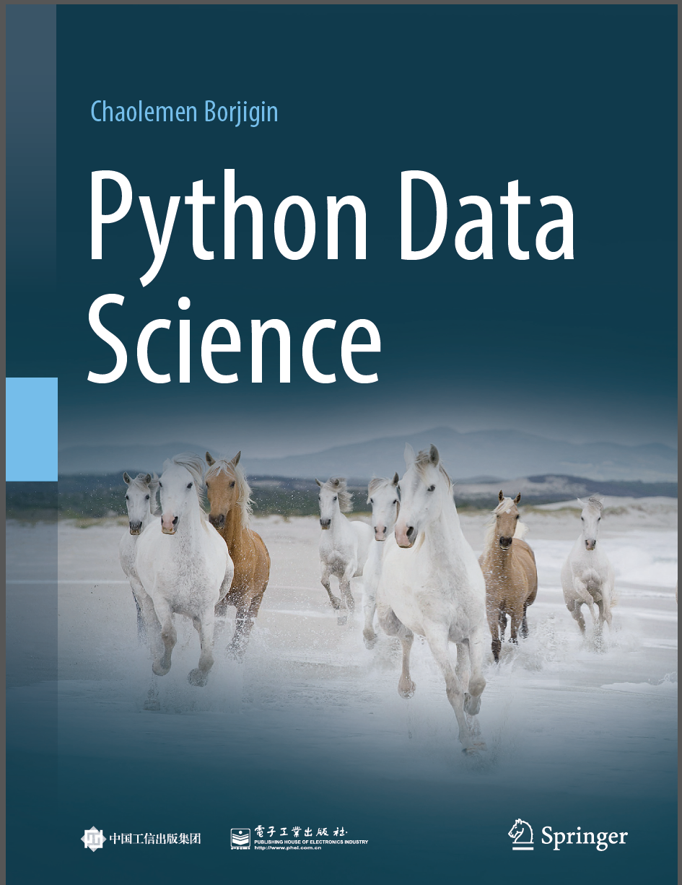
Python Data Science
Chaolemen Borjigin
Renmin University of China
chaolemen@ruc.edu.cn

Slide 2
3.8 Current working directory
▼ Chapter 3 Advanced Python Programming for Data Science
► 3.8 Current working directory
Chaolemen Borjigin
Renmin University of China
chaolemen@ruc.edu.cn

Slide 3
Summary of this chapter
▼ Chapter 3 Advanced Python Programming for Data Science
► 3.8 Current working directory
3.8.1 Getting current working directory
3.8.2 Resetting current working directory
3.8.3 Reading/writing current working directory

Slide 4
3.8.1 Getting current working directory
▼Chapter 3 Advanced Python Programming for Data Science
► 3.8 Current working directory
In[2]:
import os
print(os.getcwd())
C:\Users\soloman\clm

Slide 5
3.8.2 Resetting current working directory
▼Chapter 3 Advanced Python Programming for Data Science
► 3.8 Current working directory
In[3]:
os.chdir('E:\PythonProjects')
print(os.getcwd())
E:\PythonProjects

Slide 6
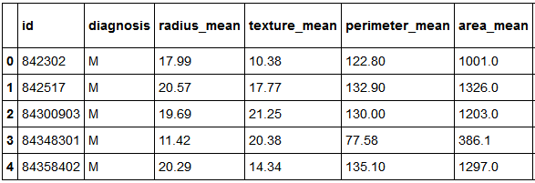
3.8.3 Reading/writing current working directory
▼Chapter 3 Advanced Python Programming for Data Science
► 3.8 Current working directory
In[4]:
from pandas import read_csv
data = read_csv('bc_data.csv')
data.head(5)
Out[4]:
5 rows × 32 columns

Slide 7


